Slide 1
BIOE 498 / BIOE 599: Computational Systems Biology for Medical Applications CSE 599V: Advancing Biomedical Models Lecture 11: Modeling Workflow
Joseph L. Hellerstein*
Herbert Sauro**
*eScience Institute, Computer Science & Engineering
**BioEngineering

Slide 2
Learning Objectives
Can do the following in combination
Fit parameters to a model
Evaluate a model using cross validation
Estimate parameter variances using bootstrapping
Diagnose deficiencies in a model and propose an improved model
Software Engineering basics

Slide 3
Computational Workflow
Postulate a Model
Predictors
Responses
Evaluate model quality using cross validation
Good?
no
Data
yes
Estimate parameter mean, variance using bootsrapping
Done
yes
Good?
no

Slide 4
Software Engineering Basics Reproducible Modeling
Create reusable functions
Comment function interfaces
Use meaningful names for variables
Write unit tests

Slide 5
Review of Fitting
import lmfit
import numpy
# Synthetic data
x = np.linspace(0, 10, 100)
AMP = 3.0
FREQ = 1.0
PHASE = 0.0
DECAY = 0.1
data = AMP*sin(x*FREQ + PHASE)*exp(-x*x*DECAY)

Slide 6
Review of Fitting
# Calculation
def calculate(x, amp, phase, freq, decay):
return amp*sin(x*freq + phase)*exp(-x*x*decay)
# Fitting
params = lmfit.Parameters()
params.add('amp', value=10)
params.add('freq', value=3)
params.add('phase', value=.2)
params.add('decay', value = 1.0)
model = lmfit.Model(calculate)
fitter = model.fit(data, params, x=x)
fitter.params

Slide 7
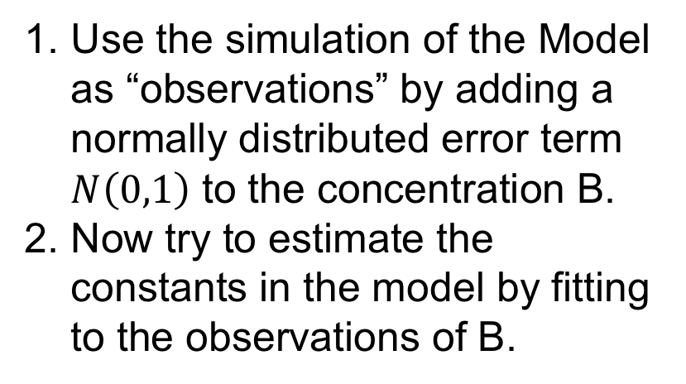
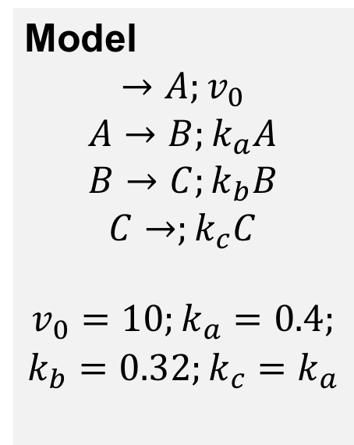
Exercise: Fitting a Simulation Model
Model
$$→A;v_{0}$$
$$A→B;k_{a}A$$
$$B→C;k_{b}B$$
$$C→;k_{c}C$$
$$v_{0}=10;k_{a}=0.4;$$
$$k_{b}=0.32;k_{c}=k_{a}$$
Use the simulation of the Model as “observations” by adding a normally distributed error term $N\left(0,1\right)$ to the concentration B.
Now try to estimate the constants in the model by fitting to the observations of B.

Slide 8
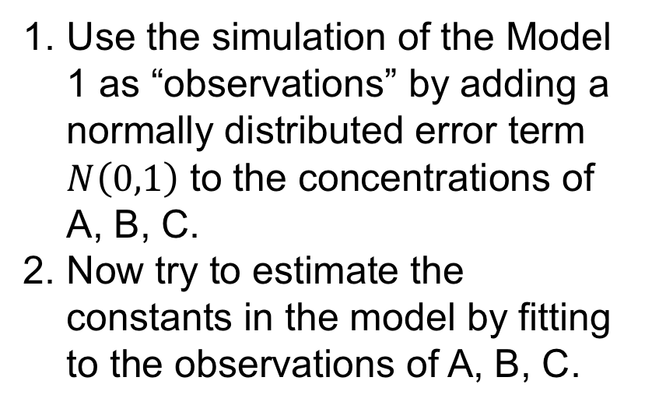
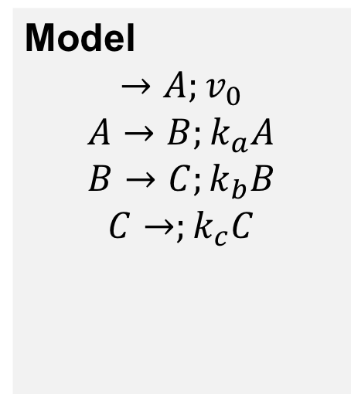
Exercise: Fitting a Simulation Model With Multiple Conceptrations
Model
$$→A;v_{0}$$
$$A→B;k_{a}A$$
$$B→C;k_{b}B$$
$$C→;k_{c}C$$
Use the simulation of the Model 1 as “observations” by adding a normally distributed error term $N\left(0,1\right)$ to the concentrations of A, B, C.
Now try to estimate the constants in the model by fitting to the observations of A, B, C.

Slide 9
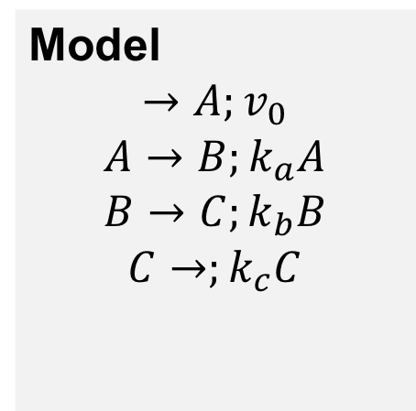
Exercise: Fitting a Simulation Model With Multiple Concentrations and Evaluation Using Cross Validation
Model
$$→A;v_{0}$$
$$A→B;k_{a}A$$
$$B→C;k_{b}B$$
$$C→;k_{c}C$$
Extend the last exercise by using cross validation to evaluate the model quality.

Slide 10

Exercise: Fitting a Simulation Model With Multiple Concentrations and Evaluation Using Cross Validation and Estimate Parameter Variability Using Bootstrapping
Model
$$→A;v_{0}$$
$$A→B;k_{a}A$$
$$B→C;k_{b}B$$
$$C→;k_{c}C$$
Extend by using bootstrapping to estimate the variability of the model parameters.

Slide 11
Discussion Question
Suppose that all you know is that there are 3 floating species (A, B, C), an input boundary species, and an output boundary species.
How would you figure out the structure of the pathway?
How would you determine the kinetics (e.g., Hill equation parameters)?

